Slide 1
I. Prospect Theory

Slide 2
Prospect Theory
Kahneman and Tversky, Econometrica 1979
Two elements, value function and weighting function
Elements replace utility function and probabilities in expected utility theory which has dominated economic thought

Slide 3
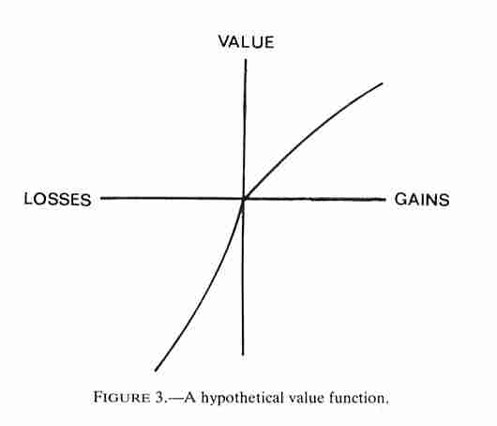
Prospect Theory Value Function

Slide 4
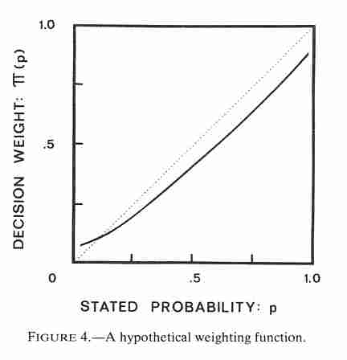
Prospect Theory Weighting Function

